Slide 1
Importance of
Threads in OS

Slide 2
Why Thread?
Multiple tasks with the application can be implemented by separate threads
  Update display
  Fetch data
  Spell checking
  Answer a network request
Process creation is heavy-weight while thread creation is light-weight
Can simplify code, increase efficiency
Kernels are generally multithreaded

Slide 3
Process and Thread
A process/task = a unit of resource ownership, used to group resources together
Processes have two characteristics:
  Resource ownership - process includes a virtual address space to hold the process image
  Scheduling/execution - follows an execution path that may be interleaved with other processes
These two characteristics are treated independently by the operating system

Slide 4
What is Thread?
Wikipedia: A thread of execution is the smallest sequence of programmed instructions that can be managed independently by a scheduler, which is typically a part of the operating system.
A Thread = a unit of dispatching/scheduling, scheduled for execution on the CPU
“Processes within processes”
“Lightweight processes

Slide 5
Processes and Threads
Processes share devices: CPU, Disk, Memory, Printer, etc.
Threads share resources: Memory space, file pointers, etc
Processes own: Threads, Memory space, file pointers, etc
Threads own: PC, registers, Stack, etc.

Slide 6
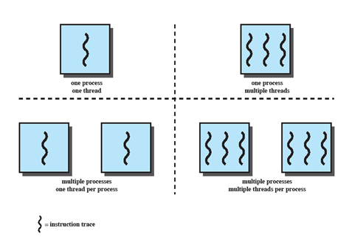
Multithreading
The ability of an OS to support multiple, concurrent paths of execution within a single process.
Notes:
Multithreading refers to the ability of an OS to support multiple, concurrent paths of execution within a single process.

Slide 7
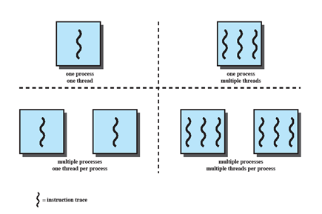
Single Thread Approaches
MS-DOS supports a single user process and a single thread.
Some UNIX, support multiple user processes but only support one thread per process
Notes:
Animated Slide
Onload Enlarges top-left to discuss DOS
Click1: Enlarges bottom-left for Unix
Single Threaded approach: The traditional approach of a single thread of execution per process, in which the concept of a thread is not recognized, examples are
MS DOS (single process, single thread)
Unix (multiple, single threaded processes)

Slide 8
Multithreading
Java run-time environment(JRE) is a single process with multiple threads
Multiple processes and threads are found in Windows, Solaris, and many modern versions of UNIX
Notes:
Animated Slide
Onload: Emphasis on top-right and JRE (single process, multiple thread),
Click 1: Emphasis on multiple processes with multiple threads – this is the main topic of this chapter
JRE is an example of a system of one process with multiple threads.
Of main interest in this chapter is the use of multiple processes, each of which support multiple threads.
Examples include:
Windows,
Solaris,
and many modern versions of UNIX.

Slide 9
Threads in Process
Each thread has
  An execution state (running, ready, etc.)
  Saved thread context when not running
  An execution stack
  Some per-thread static storage for local variables
  Access to the memory and resources of its process (all threads of a process share this)
Notes:
Within a process, there may be one or more threads, each with the following:
• A thread execution state (Running, Ready, etc.).
• A saved thread context when not running;
one way to view a thread is as an independent program counter operating within a process.

Slide 10
One view…
One way to view a thread is as an independent program counter operating within a process.

Slide 11

Threads Vs Processes

Slide 12
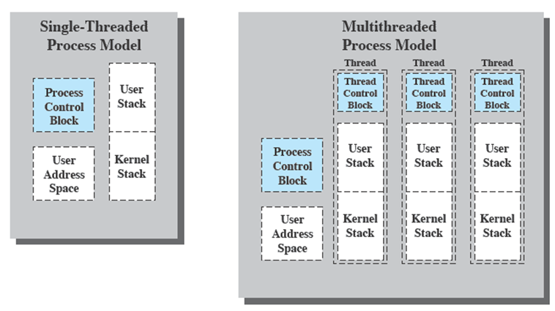
Threads vs. processes
Notes:
Distinction between threads and processes from the point of view of process management.
In a single-threaded process model, the representation of a process includes
its process control block
user address space,
user and kernel stacks to manage the call/return behaviour of the execution of the process.
While the process is running, it controls the processor registers. The contents of these registers are saved when the process is not running.
In a multithreaded environment,
there is still a single process control block and user address space associated with the process,
but separate stacks for each thread,
as well as a separate control block for each thread containing register values, priority, and other thread-related state information.
Thus, all of the threads of a process share the state and resources of that process.
They reside in the same address space and have access to the same data.
When one thread alters an item of data in memory, other threads see the results if and when they access that item.
If one thread opens a file with read privileges, other threads in the same process can also read from that file.

Slide 13
Threads vs. processes
In a single-threaded process model, the representation of a process includes
  its process control block
  user address space,
  user and kernel stacks to manage the call/return behaviour of the execution of the process.
In a multithreaded environment,
  single process control block and user address space associated with the process,
  separate stacks for each thread,
  as well as a separate control block for each thread containing register values, priority, and other thread-related state information.
Thus, all of the threads of a process share the state and resources of that process.
  They reside in the same address space and have access to the same data.
  When one thread alters an item of data in memory, other threads see the results if and when they access that item.
  If one thread opens a file with read privileges, other threads in the same process can also read from that file.

Slide 14
Benefits of Threads
Takes less time to create a new thread than a process
Less time to terminate a thread than a process
Switching between two threads takes less time that switching processes
Threads can communicate with each other
  without invoking the kernel
If there is an application or function that should be implemented as a set of related units of execution, it is far more efficient to do so as a collection of threads - rather than a collection of separate processes.
Responsiveness
Resource Sharing
Economy
Scalability
Notes:
If there is an application or function that should be implemented as a set of related units of execution,
it is far more efficient to do so as a collection of threads - rather than a collection of separate processes.

Slide 15
Thread use in a Single-User System
Foreground and background work – In spreadsheet, display/update result of formula
Asynchronous processing – To protect against power failure in word processor, write from memory to disk/input
Speed of execution – divide work
Modular program structure – various sources of input/output
Notes:
Foreground and background work
e.g. Spreadsheet
– one thread looking after display
Another thread updating results of formulae
Asynchronous processing
E.G. protection against power failure within a word processor,
A thread writes random access memory (RAM) buffer to disk once every minute.
this thread schedules itself directly with the OS;
no need for fancy code in the main program to provide for time checks or to coordinate input and output.
Speed of execution
- On thread can compute one batch of data while another thread reading the next batch from a device.
On a multiprocessor system, multiple threads from the same process may be able to execute simultaneously.
Even though one thread may be blocked for an I/O operation to read in a batch of data, another thread may be executing.
Modular program structure
- Threads make it easier to design programs which involve a variety of activities or a variety of sources and destinations of input and output.

Slide 16
Thread Execution States
States associated with a change in thread state
  Spawn (another thread)
  Block
    Issue: will blocking a thread block other, or all, threads
  Unblock
  Finish (thread)
    Deallocate register context and stacks
Notes:
A significant issue is whether the blocking of a thread results in the blocking of the entire process.
If one thread in a process is blocked, does this prevent the running of any other thread in the same process even if that other thread is in a ready state?
Clearly, some of the flexibility and power of threads is lost if the one blocked thread blocks an entire process.

Slide 17
Example: Remote Procedure Call
Consider:
  A program that performs two remote procedure calls (RPCs)
  to two different hosts
  to obtain a combined result.

Slide 18
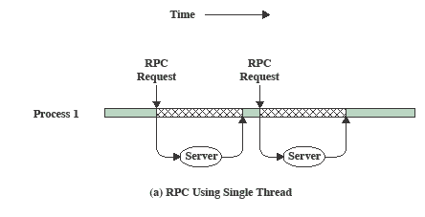
RPC Using Single Thread
Notes:
The results are obtained in sequence,
so that the program has to wait for a response from each server in turn.

Slide 19
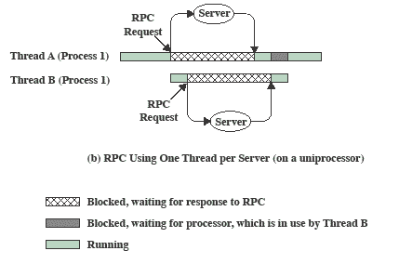
RPC Using One Thread per Server
Notes:
Rewriting the program to use a separate thread for each RPC results in a substantial speedup.
Note that if this program operates on a uniprocessor, the requests must be generated sequentially and the results processed in sequence;
however, the program waits concurrently for the two replies.

Slide 20
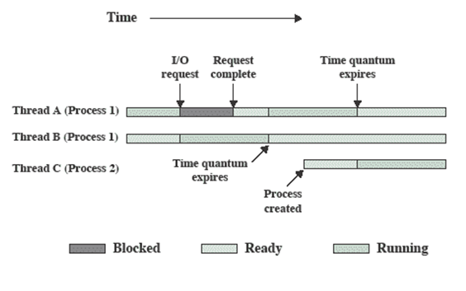
Multithreading on a Uniprocessor
Notes:
On a uniprocessor, multiprogramming enables the interleaving of multiple threads within multiple processes.
In the example,
- three threads in two processes are interleaved on the processor.
- Execution passes from one thread to another either when the currently running thread is blocked or its time slice is exhausted.

Slide 21
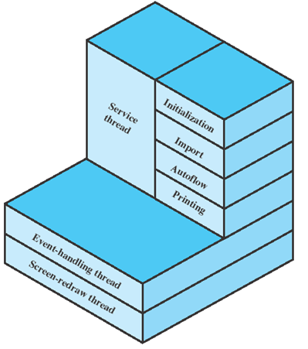
Example: Adobe PageMaker
  an event-handling thread
  a screen-redraw thread
  a service thread
Notes:
An example of the use of threads is the Adobe PageMaker application running under a shared system.
Three threads are always active:
an event-handling thread,
a screen-redraw thread,
a service thread.

Slide 22
Thread Implementation
User Level Thread (ULT)- Thread management done by user-level threads library:
  POSIX Pthreads
  Win32 threads
  Java threads
Kernel level Thread (KLT) also called kernel-supported threads/lightweight processes
  Windows XP/2000
  Solaris
  Linux
  Tru64 UNIX
  Mac OS X

Slide 23
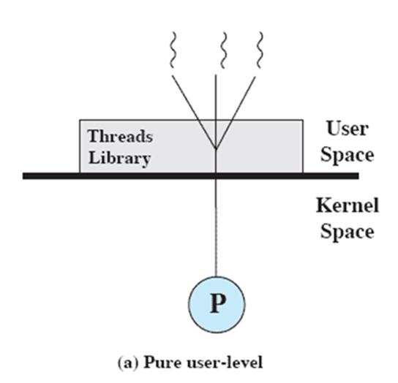
User-Level Threads
All thread management is done by the application
The kernel is not aware of the existence of threads

Slide 24
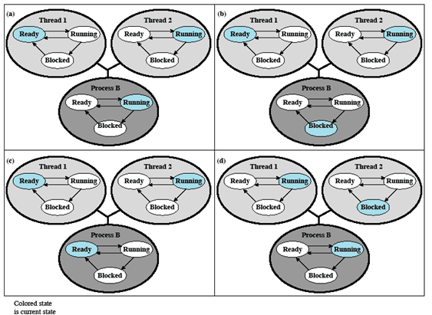
Relationships between ULT
Thread and Process States

Slide 25
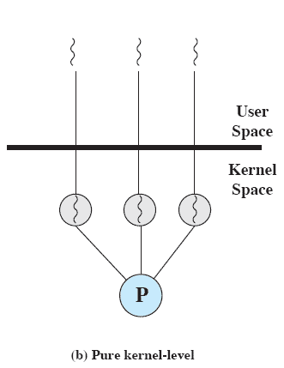
Kernel-Level Threads
Kernel maintains context information for the process and the threads
  No thread management done by application
Scheduling is done on a thread basis
Windows is an example of this approach
Notes:
The kernel maintains context information for the process as a whole and for individual threads within the process.
Scheduling by the kernel is done on a thread basis.
-

Slide 26
Advantages of KLT
The kernel can simultaneously schedule multiple threads from the same process on multiple processors.
If one thread in a process is blocked, the kernel can schedule another thread of the same process.
Kernel routines themselves can be multithreaded.

Slide 27
Disadvantage of KLT
The transfer of control from one thread to another within the same process requires a mode switch to the kernel

Slide 28
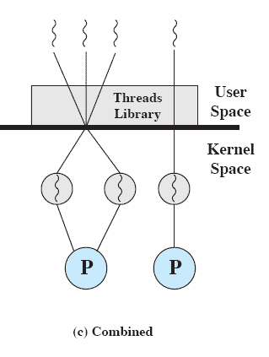
Combined Approaches
Thread creation done in the user space
Bulk of scheduling and synchronization of threads by the application
Example is Solaris
Notes:
In a combined approach, multiple threads within the same application can run in parallel on multiple processors,
and a blocking system call need not block the entire process.
If properly designed, this approach should combine the advantages of the pure ULT and KLT approaches while minimizing the disadvantages.

Slide 29
Multithreading Models
Many-to-One
One-to-One
Many-to-Many

Slide 30
Many-to-One
Many user-level threads mapped to single kernel thread
Examples:
  Solaris Green Threads
  GNU Portable Threads

Slide 31
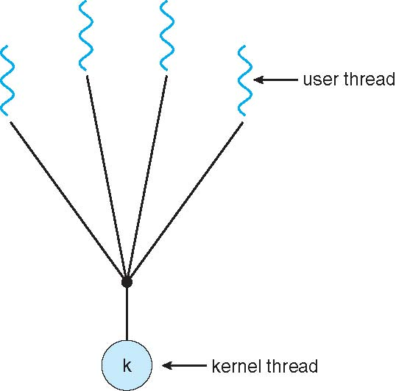
Many-to-One Model

Slide 32
One-to-One
Each user-level thread maps to kernel thread
Examples
  Windows NT/XP/2000
  Linux
  Solaris 9 and later

Slide 33
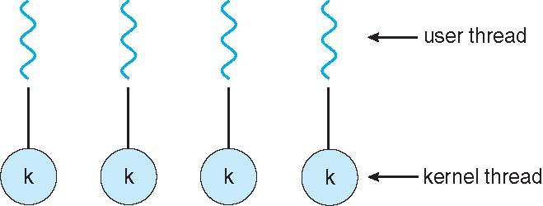
One-to-one Model

Slide 34
Many-to-Many Model
Allows many user level threads to be mapped to many kernel threads
Allows the operating system to create a sufficient number of kernel threads
Solaris prior to version 9
Windows NT/2000 with the ThreadFiber package

Slide 35

Many-to-Many Model

Slide 36
ULT Vs KLT
ULT | KLT
User thread are implemented by users. | kernel threads are implemented by OS.
OS doesn’t recognized user level threads. | Kernel threads are recognized by OS.
Implementation of User threads is easy. | Implementation of Kernel thread is complicated.
Context switch time is less. | Context switch time is more.
Context switch requires no hardware support. | Hardware support is needed.
If one user level thread perform blocking operation then entire process will be blocked. | If one kernel thread perform blocking operation then another thread can continue execution.
User level threads are designed as dependent threads. | Kernel level threads are designed as independent threads.
Example : Java thread, POSIX threads. | Example : Window Solaris.

Slide 37
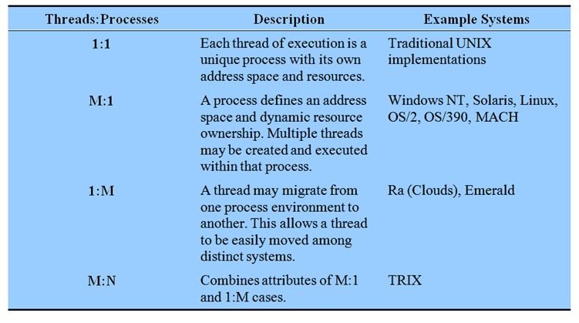
Relationship Between
Thread and Processes
Notes:
The concepts of resource allocation and dispatching unit have traditionally been embodied in the single concept of the process; that is, as a 1 : 1 relationship between threads and processes.
There has been much interest in providing for multiple threads within a single process, which is a many-to-one relationship
.
However, as the table shows, the other two combinations have also been investigated, namely,
a many-to-many relationship and
a one-to-many relationship.

Slide 38
Example- thread in C using pthread
#include <stdio.h>
#include <stdlib.h>
#include <unistd.h> //Header file for sleep(). man 3 sleep for details.
#include <pthread.h>
// A normal C function that is executed as a thread when its name is specified in pthread_create()
void *myThreadFun(void *vargp)
{
sleep(1);
printf("Printing GeeksQuiz from Thread \n");
return NULL;
}
int main()
{
pthread_t thread_id;
printf("Before Thread\n");
pthread_create(&thread_id, NULL, myThreadFun, NULL);
pthread_join(thread_id, NULL);
printf("After Thread\n");
exit(0);
}
abcd@ubuntu:~/$ gcc multithread.c -lpthread abcd@ubuntu:~/$ ./a.out
Before Thread Printing
GeeksQuiz from Thread
After Thread
abcd@ubuntu:~/$

